Slide 1
Scali conference 2015 Check a cell phone for Spyware

Slide 2
Copyright
All material in this presentation is Copyright 2015 by Joseph Seanor and PI Classroom.
Any reproduction in physical or electronic format is not allowed without the written permission of Joseph Seanor.
If you wish to use this information in a presentation of your own, or in other materials, please contact me at: jseanor@cibir.net

Slide 3
Joe Seanor
I currently hold the following certifications:
CISSP—Certified Information Systems Security Professional
NSA IAM—National Security Agency Information Assessment Methodology
CEH—Certified Ethical Hacker
CCNA—Cisco Certified Network Associate
CCDA—Cisco Certified Design Associate
MET—Master Email Tracer
Author of 17 books
10 years Central Intelligence Agency
14 years Private Investigator
7 Years AOL Senior Investigator for Computer Crime

Slide 4
NOTE
This class will only cover PUBLICALLY AVAILABLE SPYWARE.
We will not discuss any specially designed spyware or potential government based spyware.
Make sure that when you are talking with ANY of your clients you remind them that you are searching for PUBLICALLY AVAILABLE SPYWARE.

Slide 5
Cell Phone Spyware Checking…why?
Why should you have a service to check a cell phone for Spyware?
Smart phones are in use by pretty much everyone.
Crime has moved from desktops, then laptops, now to tablets/cell phones.
People keep their cell phones with them all the time, also under their control, and this makes them comfortable to do anything on their phone.
With this idea, spouses and others that suspect something is going on, will be likely to put spyware on a cell phone in order to find out.

Slide 6
Cell Phone Spyware Checking
Please note that checking a cell phone is an art and not an exact science yet.
There are new spyware and viruses that come out on a daily basis, and these are getting more and more powerful.
So whenever you represent yourself to client, be sure to make them aware of the fact that these spyware programs are getting more and more sophisticated and you can only do your best effort in order to clean the phone.

Slide 7
Spyware vs. Stalkerware

Slide 8
Spyware vs. Stalkerware
Spyware is installed by a person after jailbreaking or rooting a phone.
Stalkerware is installed by the cellphone user for the purpose of Social Networking.

Slide 9
Spyware Signs

Slide 10
Spyware signs
Here are the basic signs that there could be Spyware on a phone, and you need to ask your client about these:
Does your phone runs much slower then before?
Does the battery gets hotter then normal?
Does your battery lasts half the time it normally did?
Has your data usage has doubled?
Lets go into this questions in more detail, these are CRITICAL questions to ask and allows you to help your client further. Also, these are great questions to have on your website.

Slide 11
Spyware signs
Does your Cell Phone runs slower then normal?
This is important because with spyware installed, the cell phone must double the activity on the cell phone. And by doing so, it uses up resources on the phone, thus slowing down everything else.
You will learn, later in the class, that spyware works by duplicating all of the activity on the phone in order to upload it to the spyware servers.

Slide 12
Spyware signs
Does your cell phone battery gets hotter than normal?
This is important due to the fact that the cell phone is now working twice as hard as normal.
Remember, spyware duplicates ALL activity on the cell phone and uploads it to the spyware servers.
This means the battery is doing double the amount of work.

Slide 13
Spyware signs
Is your battery life is almost half of what it used to be?
This is important because this is one more sign that there is spyware.
Remember, spyware duplicates everything on the phone and then uploads it to the spyware server, using up battery life, making the battery last less then it normally would.

Slide 14
Spyware signs
Has your data usage doubled in the past month?
This is probably the MOST important sign of spyware.
Most of the other signs could be explained away with usage, adding more and more apps to the phone etc.
But, remember, spyware works by making a COPY of the cell phones activity. This means that data usage is DOUBLED.
I am not talking about ¼, ½, I mean DOUBLED.

Slide 15
Ownership

Slide 16
Ownership
Okay, before we get started we need to go over this, before we get started.
One of the MOST important questions you can ever ask about a cell phone, and that is OWNERSHIP.
With any work on a cell phone, you need to ask:
Who owns this phone?
If you doubt the person, ask for a copy of the most recent bill.
If they say they threw it away, have them print out the bill from their online account access.

Slide 17
Ownership
So, how do you figure out Ownership? The owner of a cell phone is:
The person who BOUGHT the phone.
AND
The person who PAYS the monthly bill
You must be BOTH in order to be considered the Owner of the cell phone.

Slide 18
Ownership
The question that YOU must answer is, do you really need to know the OWNERSHIP of a device to check for Spyware?
That is a question for you.

Slide 19
Ownership
Now, when it comes to checking for Spyware on a cell phone, what is the need to establish ownership??
The idea we are working with here is that the person, Joe, is bringing you his phone to check because he suspects his wife has put spyware on his phone.
Joe is the user right? It’s his phone right? And all you are doing is checking for spyware, not installing it.
The real issue is that if you do find spyware on the phone, ownership will allow you to determine if it was legal to put spyware on the cell phone, to a degree.

Slide 20
Ownership
This is one of the most important questions that you can ask.
Again, I am not a lawyer.
From the research that I have done online, courts are starting to focus on who purchased the phone and who pays the bill in order to determine privacy.

Slide 21
Ownership
So make sure that you asking them about this!
You may even want to get them to print out a copy of their cell phone bill
Or print out a screenshot of their online bill.
When in doubt, DON’T DO IT!

Slide 22
Ownership
NOTE!!!
Is this a business phone??
If so DON’T DO IT!!!!!
Unless you have the permission of the company owner, I would not touch a corporate phone.

Slide 23
Cases

Slide 24
Checking for Spyware Case
This will be your main request that you will have from your clients for this type of service.
This is where the client has noticed that something weird is going on with their phone.
Or that someone knows a lot of information that only occurs on their phone.

Slide 25
Pricing for Spyware Check
For a Spyware cell phone check I charge a flat rate of $100 per phone.
Again, that is PER PHONE, if they have more then one phone, I still have to do all the same checks.

Slide 26
Clients

Slide 27
Clients
So, who are the clients that you would get for this type of cell phone checking business?
Well of course you would have the following clients
Spouses
Significant others
Business owners
Others

Slide 28
Clients – – Spouses
Well with our first set of clients we would be looking at spouses.
This of course would be dealing with a potential case of infidelity.
Make sure that you know which side is dealing with the situation.

Slide 29
Clients – – Spouses
ALWAYS REMEMBER TO ASK IF THEY HAVE A TABLET, IPAD, IPOD TOUCH OR OTHER DEVICE AT HOME!!!
Remember, Spyware can be on ANY device that is running IOS, Android, or EVEN on their computer!
And computers have a microphone and cameras!

Slide 30
Client Questions
Who owns the phone?
What is the phone number?
Who is the phone provider?
Does the phone have a password?
How long have you suspected any problems?
Have you tried to check the phone on your own?
What has changed in their relationship with their spouse or SO?
Have they had a significant negative type event in their life?
Do you have a lawyer?
What other information can you provide?
Are there other phones?
What is the technology level of your spouse?
Do you have an iPad at home?
Do you have an iPod Touch?
Do you have an Android Tablet at home?
What about your laptop or desktop computer?

Slide 31
Clients – – Business Owners
Now, if you do get a client that is a business owner that comes to you about their cell phone then you’re dealing with a brand-new area.
In fact you could be dealing with multiple areas.
Business meetings
Corporate espionage
Legal issues

Slide 32
Clients – – Business Owners—IDEA!!!!
Here is a GREAT option to take to ALL of your business clients.
You should setup a contract with your business clients so that anytime they have to fire, or layoff employee’s, then you will come in and check the company cell phones for Spyware.
This is great for the business, since they will know if they have a clean cell phone, plus if there is Spyware on the phone, then the company can go after the person who put the Spyware on the cell phone.

Slide 33
Clients – – Business Owners—IDEA!!!!
Another very big idea is to approach your corporate clients with providing them spyware checking services for major meetings.
This would be useful when the client is having a very important meeting and they need to make sure everything is secure.
In order to do this, you want to make sure to set up a “bulk” price, depending on the number of phones to check.
Also, have another set of business cards that has your company information on one side, and on the back side “This cell phone has been checked and is CLEAN of any publically available spyware.”

Slide 34
Contract

Slide 35
Contract
The contract must have the following stipulations for the client to sign:
They are the owners of the phone
They are the owner of the phone with ESID ###
They pay the monthly bills for the phone with ESID #
You must also have a hold harmless clause for any potential damage to the cell phone, or computer.

Slide 36
Documents
Here is what I take with me when I meet with a client.
Cell Phone Forensics Contract
SpyWare Check Contract
Cell Phone Logging Form
Interview sheet
That is my standard pack of forms to take with me.
I will provide copies of these to you, BUT you must modify for YOUR STATE.

Slide 37
Documents
Can everyone say “Google Drive”
This is where I have stored copies of all of these documents, contracts and checklists.
You could also use Evernote for the checklists, but you will need a way to access and send out reports and contracts.
You can also use Google Keep to store your checklists on.

Slide 38
SpyWare

Slide 39
spyware
I am going to show you what the web portals of the 3 major brands of Spyware look like.
This way you can see what the options and abilities are with these Spyware products and why people use them.

Slide 40
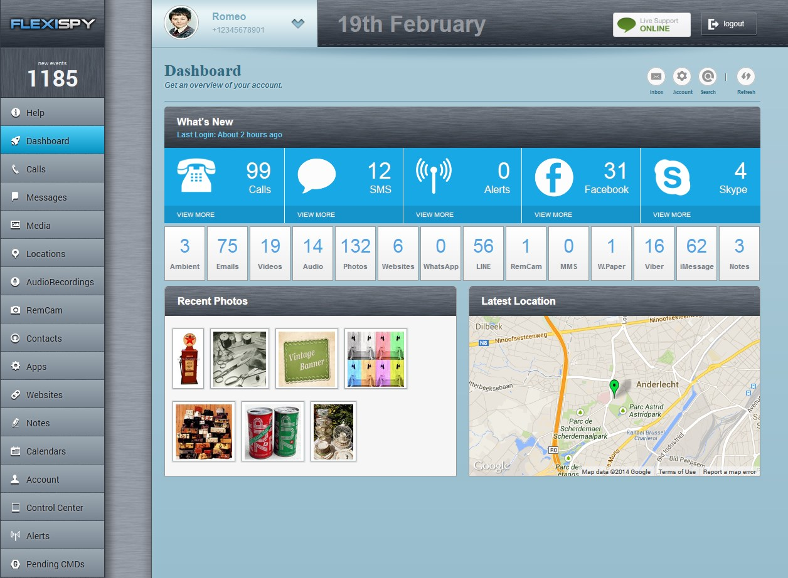
FlexiSpy

Slide 41
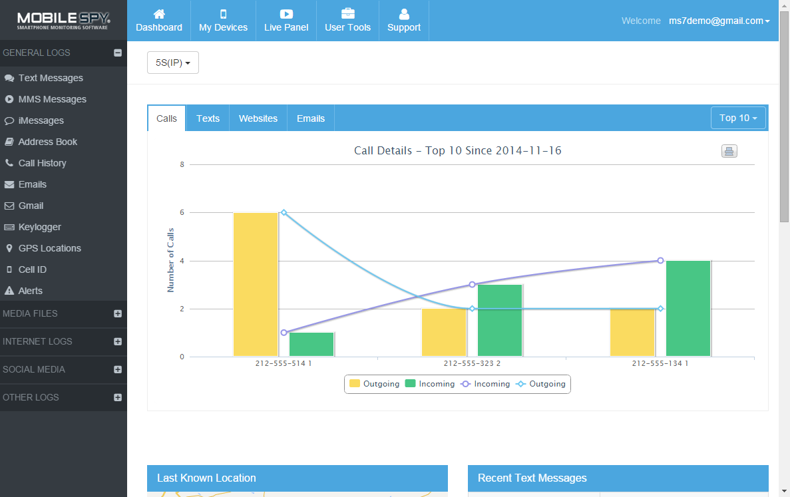
Mobile Spy

Slide 42
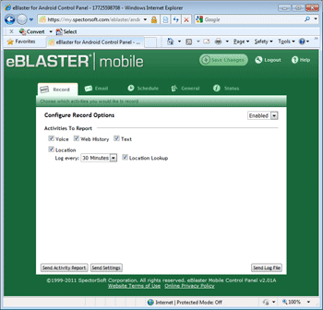
Eblaster

Slide 43
Checking an iPhone

Slide 44
iPhone Request
You will need to have a report that you can write up for each iPhone that comes into your office for a Spyware check.
Before you fill out the form, how do you get the information?
If the iPhone has a passcode, you are out of luck.
Make sure you fill out as much information as you can.
And did you take a picture of the phone???????

Slide 45
iPhone Request Form
Clients Name
iPhone Model
iPhone Carrier
iPhone OS Version
iPhone IMEI
Passcode on iPhone
iPhone number
Client Request
Jailbroken?
Spyware check Method 1
Spyware check Method 2
Spyware check Method 3
Spyware check Method 4
Notes on iPhone

Slide 46
iPhone spyware check
AGAIN NO PUBLICALLY AVAILABLE SPYWARE CAN BE INSTALLED ON AN IPHONE WITHOUT THE IPHONE/IPAD/IPOD TOUCH BEING JAILBROKEN FIRST!!!!

Slide 47
iPhone spyware check
In other words, is the iPhone jail broken or not?
If the iPhone is jail broken then you have a brand-new situation to look at.

Slide 48
What if the The phone is Jailbroken!!
Now, what does this mean?
Well, if you have a jailbroken iPhone, then that means you MIGHT have spyware.
At this point, PUT THE iPhone DOWN, WALK OUT OF THE ROOM, CLOSE THE DOOR.
Most spyware can activate the microphone, so they can hear you!

Slide 49
Checking the iPhone IOS6 and below
Recently the IOS operating system made a change to the way you access the search screen.
So, if you are working on an iPhone or iPad that is IOS5 and below, here is how you get to the Search screen.
In order to check the iPhone, you need to go to the Search screen.
This is done by swiping the screen to the RIGHT.
Which means your finger swipes from the left side to the right side.

Slide 50
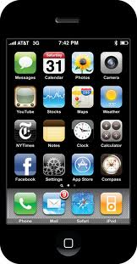
Checking the iPhone IOS6 and below
Sweep finger left to right

Slide 51
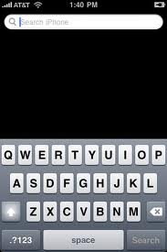
Checking the iPhone IOS6 and below
Here you will use the Search iPhone box to check for Spyware.

Slide 52
Checking the iPhone IOS7 and up
Now, if you are dealing with one of the newer iPhones, or you can’t find the search screen by sweeping your finger, that means you need to use the new method of getting to the search screen.
There are two ways that you can access the search screen on IOS 7 and above.
The first is to tap and hold at the top of the screen and “pull” your finger down.
At this point you will see the search box show up at the top.

Slide 53
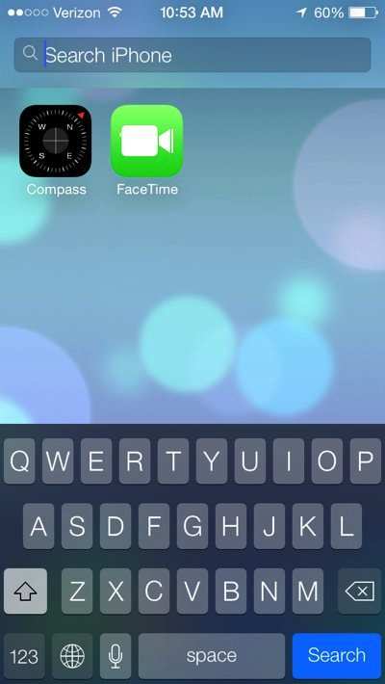
Checking the iPhone IOS7 and up

Slide 54
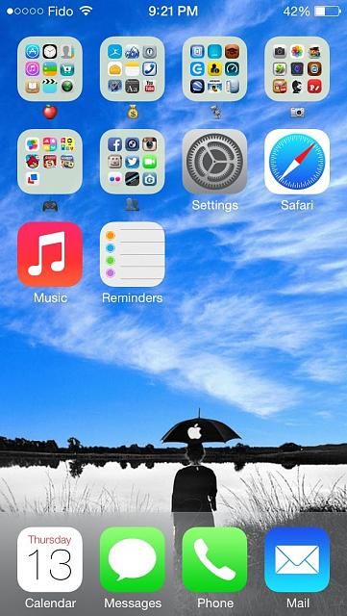
Checking the iPhone IOS7 and up
The other method, is to tap and hold your finger on a blank space on one of the screens.

Slide 55
Checking the iPhone IOS7 and up
This may mean that you have to swipe a few screens to get to one that has some space.
Once you tap and hold on the blank space, just “pull” down with your finger and you will see the search box show up at the top again.

Slide 56
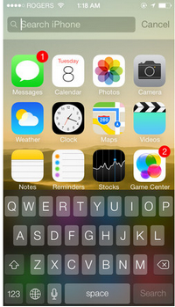
Checking the iPhone IOS7 and up

Slide 57
Checking the iPhone IOS7 and up
And now you can start checking for spyware on an iPhone or iPad!
Just make sure you do ALL of the steps below.

Slide 58
Joe’s iPhone 10 step check

Slide 59
Checking the iPhone
Now, that you are at the search iPhone box, you need to search for FOUR different programs:
Cydia
Poof
Icy
Installer
The first program is always installed with a jailbroken iPhone.
Cydia, is the “app store” of the jailbroken world, so it is always added.

Slide 60

Checking the iPhone Step 1
The first app we are going to search for is Cydia.
So, in the Search iPhone box, type in Cydia.
If the iPhone is jailbroken, you will see the following icon

Slide 61


Checking the iPhone Step 2
The next app we will look for is called POOF.
Poof, is a program that is used to hide different programs on an iPhone.
So, go the Search iPhone box, and type in Poof.
If you see the following icon, then the iPhone is jailbroken.

Slide 62

Checking the iPhone Step 3
The next app we will look for is called Bossprefs.
Bossprefs, is a program that is used to provide you a number of new functions on a jailbroken iPhone.
So, go the Search iPhone box, and type in Bossprefs.
If you see the following icon, then the iPhone is jailbroken.

Slide 63

Checking the iPhone Step 4
The next app we will look for is called Installer.
Installer, is a app that will allow you to install other iPhone applications that can run on jailbroken iPhone.
So, go the Search iPhone box, and type in installer.
If you see the following icon, then the iPhone is jailbroken.

Slide 64

Checking the iPhone Step 5
The next app we will look for is called icy.
icy, is a app that will allow you to install other iPhone applications that can run on jailbroken iPhone.
So, go the Search iPhone box, and type in icy.
If you see the following icon, then the iPhone is jailbroken.

Slide 65
Checking the iPhone step 6
Next, lets see if Flexispy is installed
Bring up the dialer on the iPhone and enter the following on the dialing pad
Enter: #123456789
If the Flexispy box shows up, you have Flexispy
Note: if they change the default code, this will not work.

Slide 66

Checking the iPhone step 7
On the iPhone, bring up the dial pad
On the dialer, enter the following: *12345
If Mobilespy is installed, you should see the Smartphone icon

Slide 67


Checking the iPhone step 8
Go to the search menu on the iPhone you are checking
Type in: iTweak
This is an alternative to Cydia, if you see it, you are jailbroken.

Slide 68
Checking the iPhone step 9
Start Safari on the iphone.
You want to check the bookmarks on the browser for:
Lima
This is an alternative to Cydia.
However, this is a BROWSER based Cydia type so there is no icon.

Slide 69

Checking the iPhone step 10
Go to the search menu on the iphone
Type in: weblin
This is an alternative to Cydia, if you see it, you are jailbroken.

Slide 70
Droid Spyware Check

Slide 71
Droid Checking
This seems like a big issue, to check a Droid for Spyware, but it really isn’t.
The Droid is very easy to check for spyware.
But, don’t let your client know how easy!

Slide 72
Droid Spyware Check Form
In order to check a droid for spyware, you should have a form that you can use to track everything.
Part of this form is the same as your Client Request form, this is because you need to make sure that YOU enter the information about the phone, instead of basing this on what your client says
Again, in order to fill out the form, use the screen previous to this that showed how to access the droid information.

Slide 73
Droid Spyware Check Form
Clients Name
Droid Model
Droid Carrier
Droid OS Version
Droid IMEI
Passcode on Droid
Droid number
Client Request
Rooted?
Spyware check Method 1
Spyware check Method 2
Spyware check Method 3
Spyware check Method 4
Spyware check Method 5
Notes on Droid

Slide 74
Joe’s kinda android 12 step check

Slide 75
Checking the Droid
In order to check the Droid, you will need to install a program called Connectbot.
Both of these programs are terminal programs that allow you to open a terminal window on the droid.
Once you open a terminal window, you can now check to see if the phone is rooted.
You can download or Connectbot from the Android Marketplace

Slide 76

Installing Terminal
First, on the CLIENTS droid, and look for the Play Store icon and tap on it in order to open it up.

Slide 77
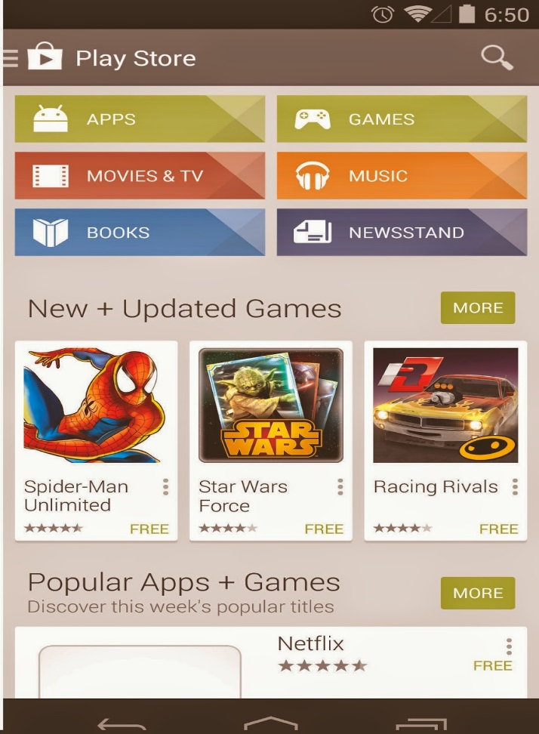

Installing Terminal
Now, that you have the market open, you want to click on search and type in or Connectbot.

Slide 78

Installing Terminal
Once the app is installed, then just click on the Connectbot icon

Slide 79
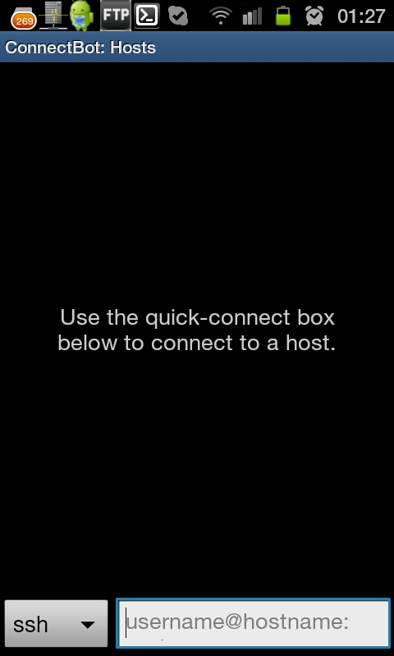
Terminal
Once you click on the Connectbot icon, you will then need to choose the option that says SSH.
When you click on it, choose local.

Slide 80
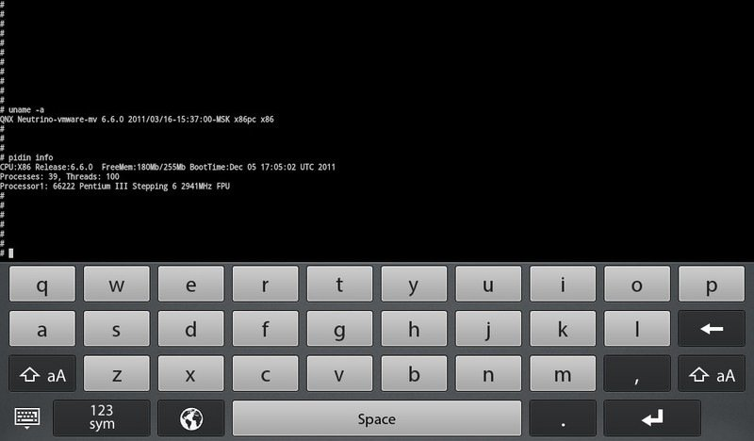
Terminal
When you choose local, you will see in the box next to it, Enter Nickname.
Tap the box, and then when the keyboard shows on the screen, just press the enter key.
You will see the terminal open up.

Slide 81

Droid Check step 1
Now, that you are at the prompt, it is time to check the Droid to see if it is rooted.
The very first check is to look at the prompt.
If you see: $
Your OK

Slide 82
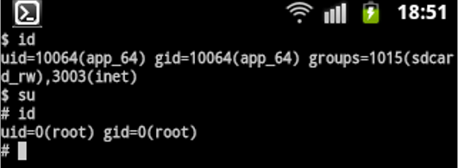
Droid Check step 1
If you see a #
YOUR ROOTED!!!!

Slide 83
Droid Check step 2
The second check you need to do is from the terminal window, again, is type:
cd /data/app-private
If you can get to that directory, then your ROOTED

Slide 84
Droid Check step 3
The third check you need to do is from the terminal window, again, is type:
ls
Now, pick a file from that list, and you are going to try and copy it to a different directory.
cp filename /data
If you can copy the file, then your ROOTED

Slide 85
Droid Check step 4
Here is the next check that you want to do for spyware on the Droid.
On the main screen of the Android device, open your main menu and tap on your Settings icon to bring up your Settings Menu.
Once the Settings Menu opens, scroll down through the menu and locate the Applications field.
Tap it.

Slide 86
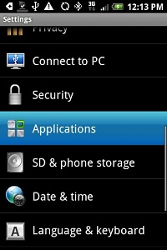
Droid Check step 4

Slide 87
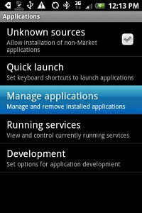
Droid Check step 4
In the Application Settings menu, tap on the Manage Applications field.

Slide 88
Droid Check step 4
In the Manage Applications menu, scroll through the list of applications until you find:
Android Toolkit for Mobile Spy Version 5.0
Smartphone for Mobile Spy Version 4.0.
If you find either one of these, you have Spyware!

Slide 89
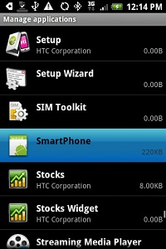
Droid Check step 4

Slide 90
Droid Check step 5
Here is the next check that you want to do for spyware on the Droid.
On the main screen of the Android device, open your main menu and tap on your Settings icon to bring up your Settings Menu.
Once the Settings Menu opens, scroll down through the menu and locate the Applications field.
Tap it.

Slide 91
Droid Check step 5
In the Application Settings menu, tap on the Manage Applications field.

Slide 92

Droid Check step 5
In the Manage Applications menu, scroll through the list of applications until you find:
If you see the application name “FSXGAD_1.XX.XX.apk”.
You have Spyware!

Slide 93
Sixth Droid Check
Here is the next check that you want to do for spyware on the Droid.
On the main screen of the Android device, open your main menu and tap on your Settings icon to bring up your Settings Menu.
Once the Settings Menu opens, scroll down through the menu and locate the Applications field.
Tap it.

Slide 94
Droid Check step 6
In the Application Settings menu, tap on the Manage Applications field.

Slide 95
Droid Check step 6
In the Manage Applications menu, scroll through the list of applications until you find:
If you see the application name “System Sync”.
Or look for “Android System Providers”
You have Spyware!

Slide 96
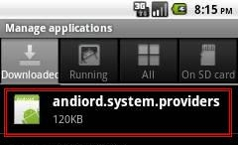
Droid Check step 6

Slide 97
Droid Check step 7
The following is a list of spyware apps that you can look for that if they are found on the phone, you have spyware!
These are running apps, so you follow the same procedure as before.

Slide 98
Droid Check step 7
Android System Log---running app
Superuser---running app (rooting of Android)
SIM Toolkit---running app
GPS Settings---running app
Android Toolkit---running app
Smartphone---running app
speach recorder tips---running app

Slide 99
Droid Check step 8
This step will be a very through check for spyware.
You will need to get to the list of Applications running on the android phone.
Once there you will click on each application that you see.

Slide 100
Droid Check step 8
It will then take you to the page to either “Force Stop” or “Uninstall”.
Next, just scroll down that page and you will see permissions.
Make sure that the app matches the permissions that it has listed.

Slide 101
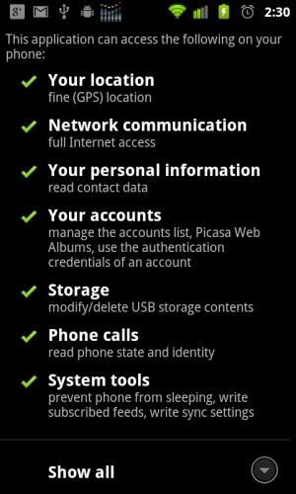
Droid Check step 8

Slide 102
Droid Check step 9
Next you want to take the phone and check the SD card.
If there is no SD card, you will want to check the internal storage in the downloads section.
At both of these locations, you are looking for any .apk files.

Slide 103
Droid Check step 9
With the android phone, when a app is install via the Google Play Store, it is NOT stored in the downloads area.
So, if you find any .apk files in the SD card or internal storage THESE ARE SUSPECT!

Slide 104
Droid Check step 9
Next, we are going to check the file system for the folders and files of Spyware.
You will need to check in TWO main places on the android phone
You will need to look in the main storage download area, and then on the SD card, ALL of the sd card (downloads first)

Slide 105
Droid Check step 9
The first list we will check for are for any APK files.
APK files are the file extension for a application.
If you find any APK files in the internal storage download area: YOU HAVE A POSSIBLE PROBLEM!

Slide 106
Droid Check step 9
If you find any APK files in the SD Card ALL of it, and also the download area: YOU HAVE A POSSIBLE PROBLEM!
You need to Google each of the APK names to see if they are Spyware.
The following is a list as of Sept 2015

Slide 107
Droid Check step 9
Mobistealthv2.apk
ms5--2.1--above.apk
FSXGAD_2.03.3.apk
Radio.apk
spy.phone.v1.0.17.apk
spymouse.v1.0.6.apk
spc.apk
statusswitch.apk
accessiblity.preferences.apk
1mole_4x.apk
hellospy.apk
invisible.apk
omegatarget2.x.apk
sms.spy.full.apk
splsc32.apk
spb-mobile-shell3d.apk
Ms65.apk

Slide 108
Droid Check step 10
This will be the final check for spyware on an android phone.
Here we are going to use the file explorer in order to look in certain areas for the signs of spyware files.
When spyware is installed, data is stored on the phone in specific folders

Slide 109
Droid Check step 10
Radio.apk--/mnt/sdcard/Download
LookOut.secure--/data/data
Loggedpictures.ser--/data/data
Configuration.xml--/data/data
FSXGAD_2.03.3.apk--/mnt/sdcard/Download
ms5--2.1--above.apk--/mnt/sdcard/Download
MobileSpyData6.0.xml--/data/data/com.re=na22.ms6

Slide 110
Droid Check step 11
Next, lets see if Flexispy is installed
Bring up the dialer on the Android and enter the following on the dialing pad
Enter: #123456789
If the Flexispy box shows up, you have Flexispy
Note: if they change the default code, this will not work.

Slide 111
Droid Check step 12
On the Android, bring up the dial pad
On the dialer, enter the following: *12345
If Mobilespy is installed, you should see the Smartphone icon

Slide 112
Android Checks
Those are all the checks that you need to do for an android phone in order to check for spyware on the device.
You can either do all of the android checks as a service, or you can just do the 8 checks.
If you end up doing all of them, you are really checking for everything!!

Slide 113
Reports

Slide 114
Reports
As with any investigative service, you will need to provide reports on the type of work you did.
There are three types of reports that we are going to cover in this class.
Phone Intake Form
Spyware Check Report
Advanced Spyware Check Report

Slide 115
Reports
There are two ways that you can handle these reports:
Paper
Online
I prefer to use the online method for dealing with the reports, since I can fill out everything on my phone and send the report to them.
You can store a copy of the reports on your phone or at a dropbox account.

Slide 116
reports
To save time with this, since most of the checks that I do, I finish in less than 20 minutes, I make sure I keep a set of reports on my Google Drive.
On my Google drive I have 4 files
iPhone Spyware Report
iPhone Spyware Report CLEAN
Android Spyware Report
Android Spyware Report CLEAN

Slide 117
reports
Now if you notice, I have a version of iPhone and Android that is titled CLEAN.
This is what I use the MAJORITY of the time, since I have only found 3 cellphones with Spyware on them, or the left-overs of them.

Slide 118
iPhone Spyware Report
Clients Name
iPhone Model
iPhone Carrier
iPhone OS Version
iPhone IMEI
Passcode on iPhone
iPhone number
Jailbreak Check
Spyware check Method 1
Spyware check Method 2
Spyware check Method 3
Spyware check Method 4
Spyware check Method 5
Spyware check Method 6
Spyware check Method 7
Spyware check Method 8
Spyware check Method 9
Spyware check Method 10
Notes on iPhone

Slide 119
Droid Spyware Check Report
Clients Name
Droid Model
Droid Carrier
Droid OS Version
Droid IMEI
Passcode on Droid
Droid number
Rooted?
Spyware check Method 1
Spyware check Method 2
Spyware check Method 3
Spyware check Method 4
Spyware check Method 5
Spyware check Method 6
Spyware check Method 7
Spyware check Method 8
Spyware check Method 9
Spyware check Method 10
Spyware check Method 11
Spyware check Method 12
Notes on Droid

Slide 120
Make them sign a contract first!!
Remember, you must make sure that your clients sign a contract with you first before you begin the work on their cell phone.

